Slide 1
Trends in Periodic Table

Slide 2
Trends in the Periodic Table

Slide 3
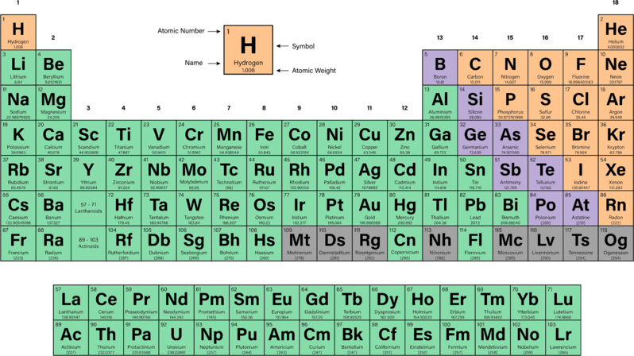
You will look at key properties including location of metals, non-metals and metalloids on the periodic table, and will learn about some trends seen as you move across and down the periodic table.

Slide 4
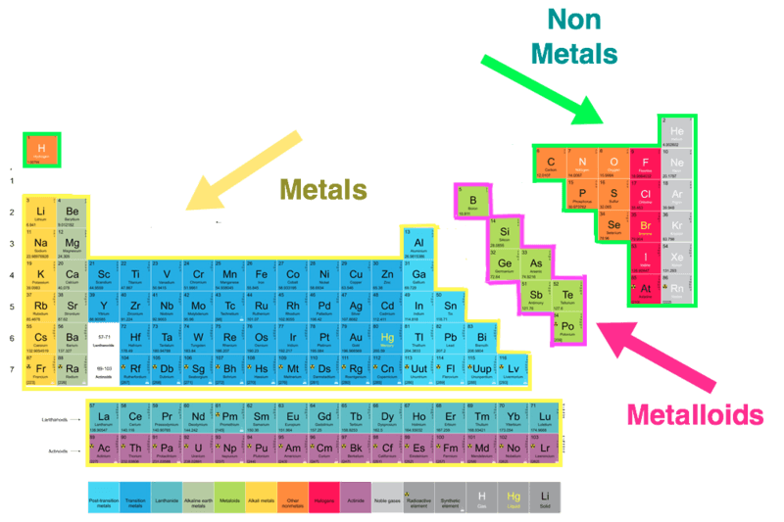
The periodic table is divided into three categories:
The metals on the left.
The non-metals on the right (plus hydrogen).
The metalloids on the border between metals and non-metals.

Slide 5
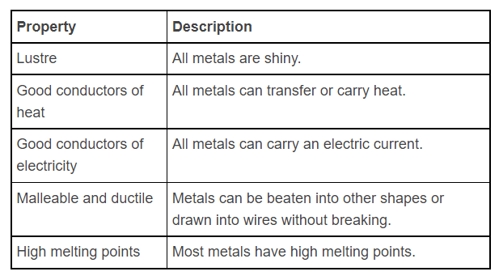
Metals make up most of the periodic table, 91 of the current 118 known elements are metals!
Metals all have the following properties:

Slide 6
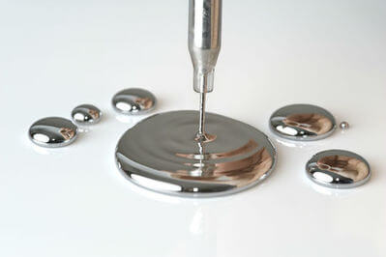
Though there are considerably fewer non-metals than metals, they have considerably more variation.
For example, there is only 1 metal which is not a solid (mercury, which is a liquid). In the non-metals there are 11 gases, 5 solids and 1 liquid.

Slide 7
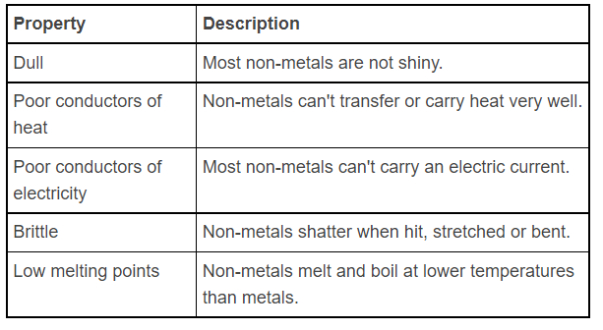
In contrast to metals, non-metals have the following properties:

Slide 8
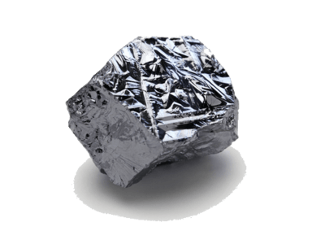
Metalloids (sometimes called semi-metals) have similar properties to both metals and non-metals.
They tend to look more like metals, but act more like non-metals.
For example, silicon is shiny, but also brittle and only a semiconductor (will conduct electricity under certain circumstances).
Most periodic tables will represent the metalloids with a zig-zag line
6 of 42

Slide 9
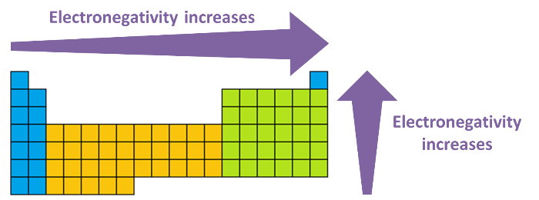
Electronegativity is a measure of how strongly an atom attracts electrons.
Electronegativity increases as you go to the right of the table, and as you go up the table.

Slide 10
The electronegativity affects how an element will react.
An element with a high electronegativity, such as oxygen, is going to be very good at taking electrons.
An element with a low electronegativity, such as caesium, is going to be very good at losing electrons.

Slide 11
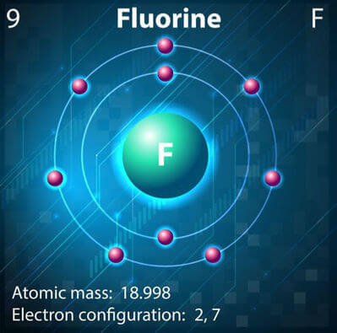
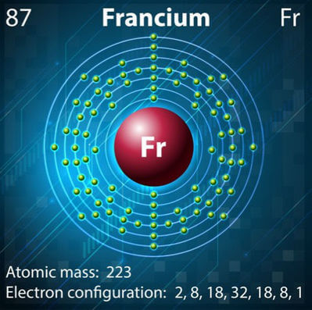
Fluorine is the most electronegative element.
Francium is the least electronegative element.

Slide 12
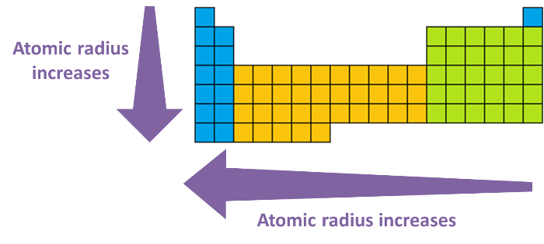
The atomic radius is the distance from the nucleus to the outer electrons.
Atomic radius increases as you move to the left of the table, and as you go down the table.

Slide 13
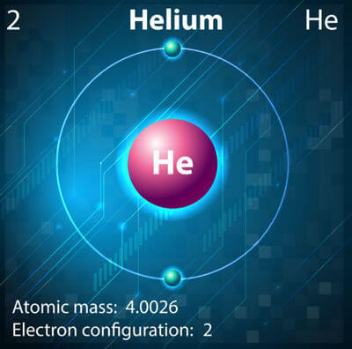
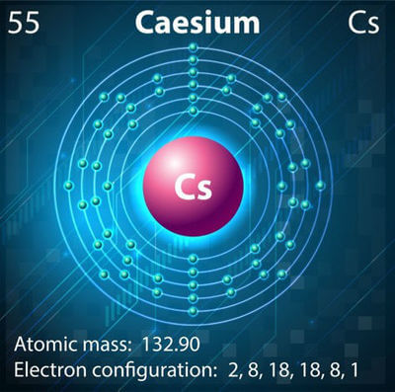
Helium has the lowest atomic radius.
Caesium has the highest known atomic radius.

Slide 14
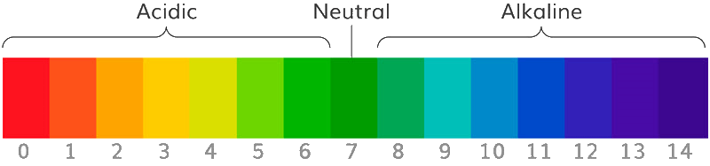
Due to the patterns in atomic structure and properties, there are also some trends seen in the compounds formed.
An example is the oxides of the elements, which change from basic through amphoteric to acidic across a period.
The alkali metals (group 1), as their name suggests, form strongly basic oxides. As you move across the periodic table to the non-metals, such as carbon, nitrogen, sulphur and fluorine, the oxides become acidic. (Again hydrogen is an exception, being placed above group 1, but forming a neutral oxide, H_{2​}O.)

Slide 15
Periodic Trends: Electronegativity

Slide 16
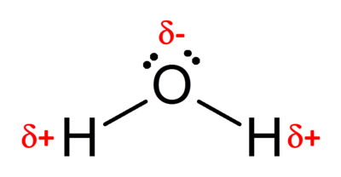
Electronegativity is a measure of an atom's tendency to attract a bonding pair of electrons.
The attraction an atom has for electrons depends on the number of protons in the nucleus, the distance between the nucleus and the bonding electrons (i.e. atomic radius), and the shielding effects from electrons in inner shells.
A large electronegativity value means the attraction between the nucleus and the bonding electrons is strong.
When two elements are bound together that have different electronegativities a polar bond is formed. This is because the electron density is higher around one atom than the other. For example, in water, oxygen has a higher electronegativity than hydrogen so the electrons in the O−H bond are found closer to the oxygen atom than the hydrogen atom. (The aδ symbol represents a small amount of charge).

Slide 17
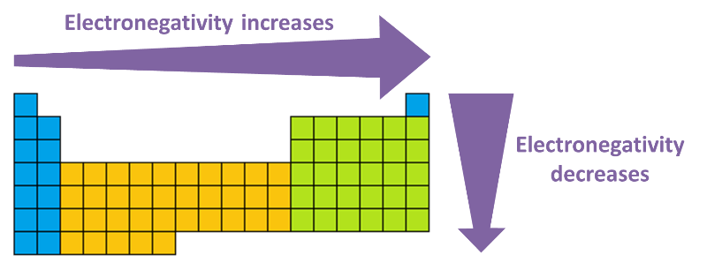
Electronegativity increases across a period and decreases down a group.
This means that the most electronegative atoms exist at the top-right corner of the periodic table with the exception of the group 18 noble gases, which do not have electronegativity values. An easy way to remember this is that fluorine is the most electronegative element, and the farther you go from fluorine, the less electronegative the element will be.

Slide 18
What causes the changes in electronegativity?
Across a period the electronegativity increases because the number of protons in the nucleus increases while the valence electrons are in the same energy level. This means the electrostatic attraction between the nucleus and the electrons is stronger.
When going down a group the increase in atomic radius means that electrons are situated farther away from the nucleus, so the electrostatic attraction and thus electronegativity decreases.

Slide 19
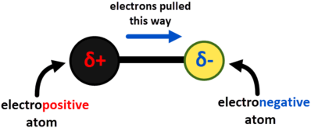
Electronegativity is measured on a relative scale known as the Pauling scale.
The most electronegative element is fluorine, and it was arbitrarily given a value of 4.0 on the Pauling scale and all other elements were measured relative to this.
Pauling proposed the concept of electronegativity in 1932 to explain the fact that some experimentally observed covalent bond strengths were stronger than the theoretical ones. Pauling reasoned that this difference in bond strengths was due to an additional ionic contribution to the bond due to uneven sharing of electrons.

Slide 20
Periodic Trends: Ionisation Energy

Slide 21
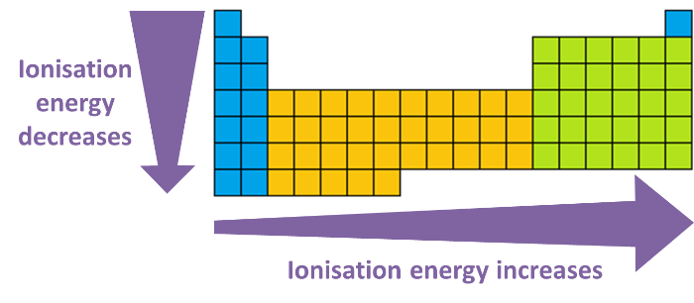
In this Smart Lesson you will learn to:
• | Describe the property of atoms known as ionisation energy.
• | Explain how an atom's ionisation energy can be estimated based on its position in the periodic table.

Slide 22
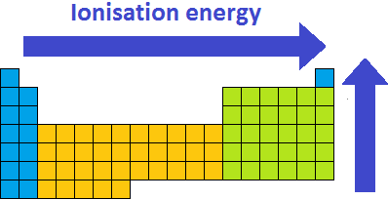
Ionisation energy is another property of an atom that displays a periodic trend.
The ionisation energy of an element is the amount of energy required to remove one valence electron from an atom in its gas form.
As expected this follows the same trend as electronegativity for the same reasons. The atoms with the highest ionisation energies are located at the top-right of the periodic table, including the noble gases.

Slide 23

The first ionisation energy is the minimum energy required to remove an electron from each atom in one mole of gaseous atoms.
Several factors influence ionisation energy, mostly by altering the electrostatic attraction between the nucleus and the electrons.
The electrostatic attraction decreases with distance from the nucleus, which means larger atoms tend to have lower ionisation energies and it is easier to remove electrons from them. This is also because of electron shielding (or screening) by electrons within inner electron shells decreasing the attraction between valence electrons and the nucleus.

Slide 24
Periodic trends in ionisation energy.
Going down a group, the number of electron shells increases, which means that the valence electrons are found farther from the nucleus and the electrostatic attraction is weaker. This means it is easier to remove the first electron and the first ionisation energy decreases.
Going across a period, the number of protons in the nucleus increases, but the distance between the nucleus and valence shell is the same. This means the electrostatic attraction is stronger, making it harder to remove an electron and increasing the ionisation energy.

Slide 25
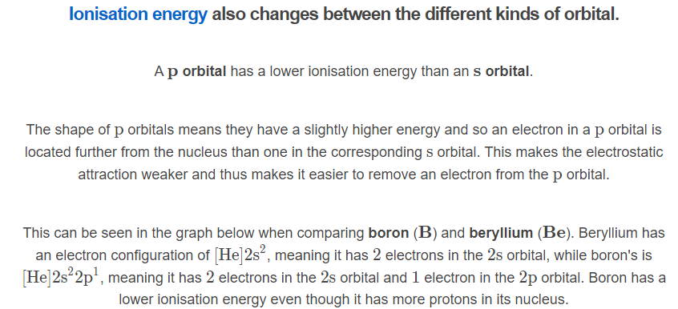
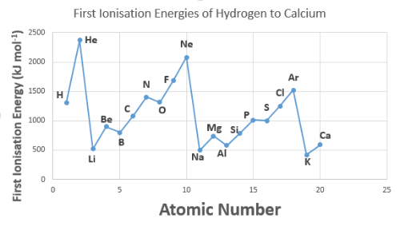

Slide 26

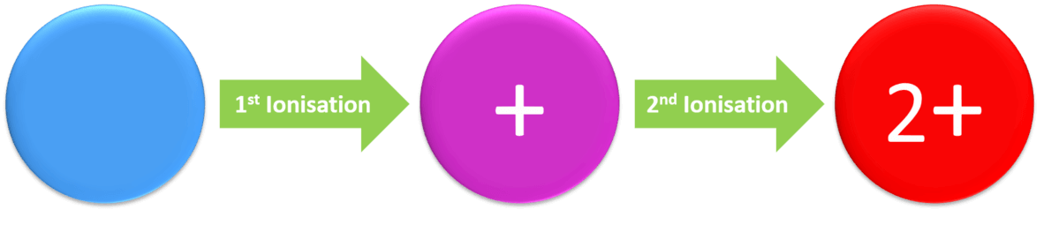
Second ionisation energy.
Just like the first ionisation energy is the energy required to remove the first electron from a neutral atom, the second ionisation energy is the energy required to remove the second electron from the X⁺ ion.
The first ionisation energy is always smaller than the second, which is smaller than the third, etc. This is because the remaining electrons are more strongly attracted to the nucleus each time one is removed (because the number of protons in the nucleus does not change).

Slide 27
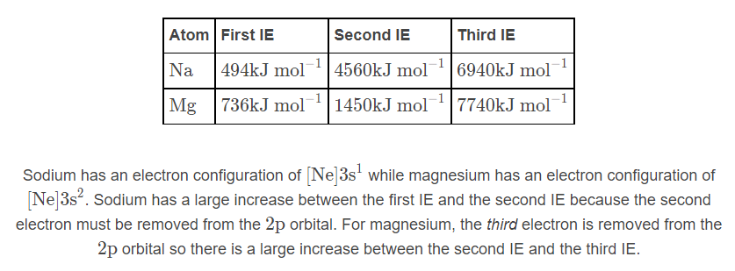
Each time an electron shell is removed, the next ionisation energy becomes much greater.
The electrostatic attraction is much stronger for electrons closer to the nucleus. For example, compare sodium and magnesium:

Slide 28
Periodic Trends: Metallic Character

Slide 29
In this Smart Lesson you will learn:
• | What causes elements to be metallic or non-metallic.
• | How this character can be explained by the electron configuration of an element.
• | That the metallic or non-metallic character of an element can be determined based on its position in the periodic table.

Slide 30
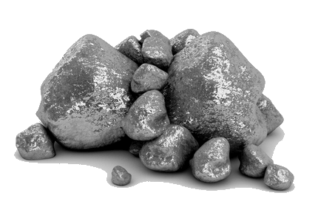
Another trend in the periodic table is metallic character. This refers to how metallic an element is, based on other properties such as electrical and thermal conductivity, and how easily it can be bent.
Most of the properties of a metal can be explained by how strong the attraction between the nucleus and electrons is.
For example electrical conductivity can be explained as electrons being able to move through metal. The less attraction between the electrons and nucleus the more conductive a metal is.

Slide 31
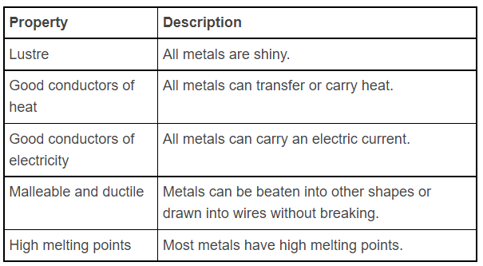
Metals all have the following properties:

Slide 32
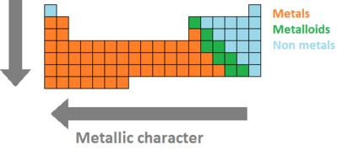
The metallic character decreases across a period and increases going down a group. The "most metallic" elements are located at the bottom-left of the periodic table.
The periodic table can also be divided into metals, non-metals and metalloids which have both metal and non-metal characteristics.

Slide 33
When going across a period the metallic character of elements decreases. This is because the valence electrons stay in the same electron shell, but more protons are added to the nucleus. This in turn causes electrons to be more attracted to the nucleus.
When going down a group the metallic character of elements increases. This is because of the additional electron shells which place the valence electrons farther from the nucleus. Subsequently this reduces the attraction between the electrons and the nucleus.

Slide 34
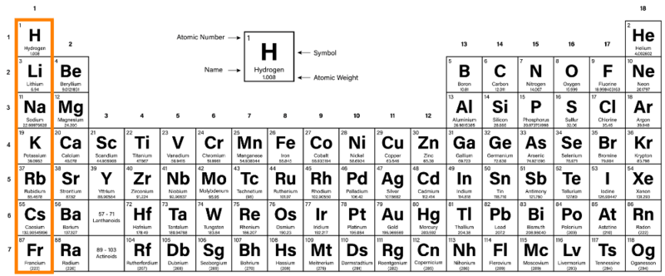
The first Group of the periodic table is the alkali metals. These are on the far left of the table (Group I) and show mostly typical metallic properties. Hydrogen is often drawn at the top of this group, as it has one valence electron, but it is NOT an alkali metal and has very different properties.

Slide 35


Group 1 elements are known as the alkali metals.
All alkali metals are highly reactive and, due to having 1 valence electron, form ions with a charge of +1.
Reactivity increases as you move down the group. This is because the valence electrons are getting further from the nucleus, and are easier to remove.

Slide 36

Alkali metals are very soft and you can cut most of them with a knife.
Alkali metals react violently with water. Any alkali metals stored in your school will probably be completely submerged in oil to avoid unwanted reactions.

Slide 37
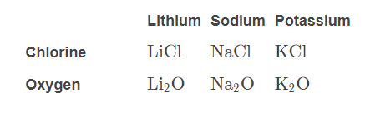
Alkali metals will react to produce similar compounds.
For example:
They will all react with chlorine to form ionic compounds with the formula XCl, where X is an alkali metal.
They will all react with oxygen to form ionic compounds with the formula X_{2​}O, where X is an alkali metal.

Slide 38

Group 17 elements are known as halogens. As they are found on the right side of the periodic table, they are non-metals, so do not show metallic properties.
Halogens are quite reactive. Halogens have 7 valence electrons, and can form 1 covalent bond (share 1 electron), or ions with a charge of −1 (take 1 electron).
Reactivity decreases as you move down the group. This is because the electronegativity decreases as the outer shell gets further away.

Slide 39
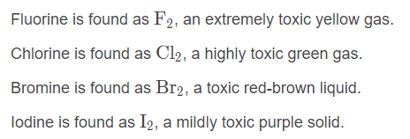
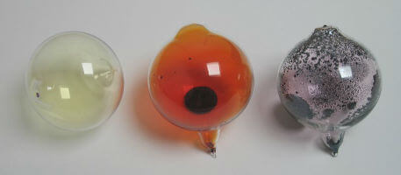
Halogens all bond covalently to form diatomic molecules (molecules with two atoms). Halogens are typically coloured, and toxic.

Slide 40
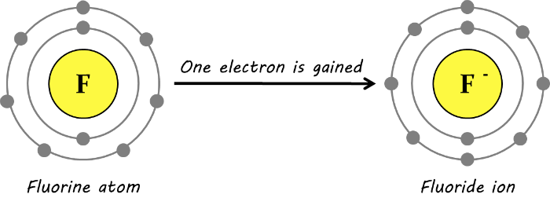
Halogens can bond covalently or ionically; they can form 1 covalent bond (by sharing 1 electron), or an ion with a charge of −1 (by taking 1 electron).
This picture shows fluorine gaining an electron, becoming a fluoride ion.

Slide 41

Halogens are reactive because they are only 1 electron from fulfilling the octet rule, and have the electronegativity to easily gain this electron.
Halogens are toxic because they can react with most of the chemical compounds in your body! This is why the most reactive halogens are the most toxic.

Slide 42
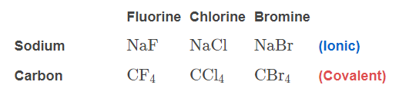
Halogens all form similar compounds.
For example:
Halogens will react with sodium to form an ionic compound with the formula NaX, where X is any halogen.
Halogens will react with carbon to form a covalent compound with the formula CX_{4​}, where X is any halogen.

